Slide 1

MAJOR PROJECT (EE499)
Submitted by-
Nandani shakshi(16EE235)
Neelam bugalia(16EE236)
Rachna meshram(16EE238)
Under the guidance of-
Dattatraya N Gaonkar

Slide 2
CLASSIFICATION OF
POWER QUALITY EVENTS
USING
MACHINE LEARNING TECHNIQUES

Slide 3
PROBLEM STATEMENT:
To collect the real time data for different power quality events and extract the required features to make the dataset using machine learning techniques and then further classify the events with the use of CNN.

Slide 4
OBJECTIVES
To collect the real time data from the pqubes.
To generate data for events that are combination of two power quality disturbances.
To extract different features from the data.
To make the dataset for each event.
To classify them using CNN.

Slide 5
POWER QUALITY:
Power quality is an issue that is becoming increasingly important to electricity consumers at all levels of usage.
The Term Power Quality Is Used To Describe Any Non-stationary Disturbances, Which Cause The Major Malfunctioning Of The Electrical Equipments.

Slide 6
DATA COLLECTION:
The real time data is collected from different PQube across the globe. The PQube is an PQ monitoring device that records the details of every power disturbance. When the system is normal, PQube records every detail about power consumption. Also data for multiple events was generated using python.

Slide 7
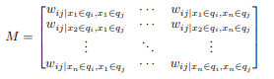
We managed to collect data for following events:
Voltage sag
Voltage swell
Abnormal frequency
Waveform distortion
Nominal case (No fault)
But during the feature extraction process, we came across some special cases.

Slide 8
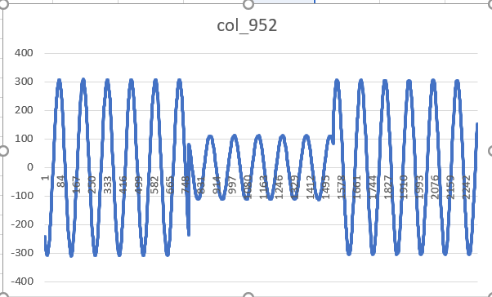
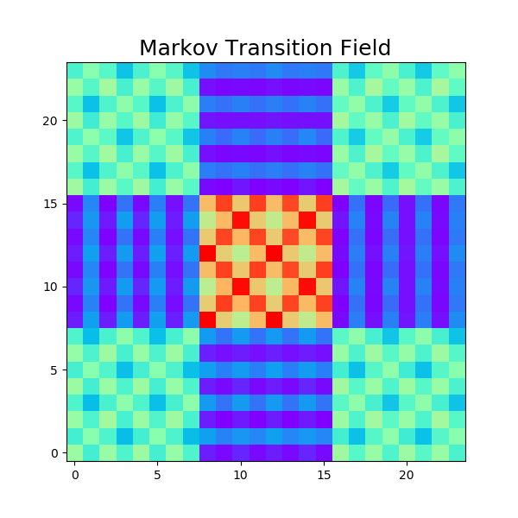
Special Case (Data with multiple disturbances)

Slide 9
Generated Events:
Under-frequency and Under-voltage
Over-frequency and Over-voltage
Flickers and Transients
We have generated our data using numerical model framework, where power system sine function is multiplied with power quality event function to derive the model.

Slide 10
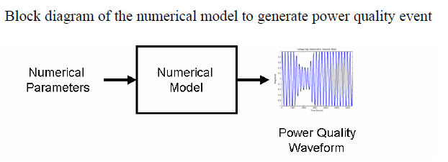
NUMERICAL MODEL FRAMEWORK:
m(t) = Multiplying Power Quality event function (ex.- Sag, Swell, Flicker etc.)
a(t) = Additive Power Quality event function (ex.- Transients, Voltage Notch, Harmonics, Noise etc.)

Slide 11
Numerical Model for over frequency and over voltage:
Where,
Vm=peak voltage
Vr =rise in voltage
f=fundamental frequency
fr=rise in frequency
t=time
φ=phase angle

Slide 12
Numerical Model for under frequency and under voltage:
Where,
Vm=peak voltage
Vd =drop in voltage
f=fundamental frequency
fd=drop in frequency
t=time
φ=phase angle

Slide 13
Numerical Model for Flickers and Transients:
Where,
Fm = Flicker magnitude (6-10 % of nominal voltage)
ff = Flicker frequency (10 Hz)
Tm = Transient magnitude (1.4 times of nominal voltage)
fosc = Transient oscillatory frequency (400 Hz)
P = Transient settling rate
ts = Transient settling time (0.015)
t1 = Transient starting time

Slide 14
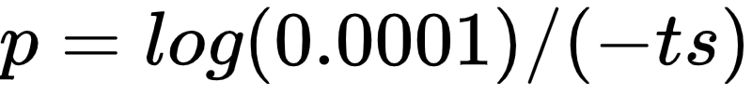
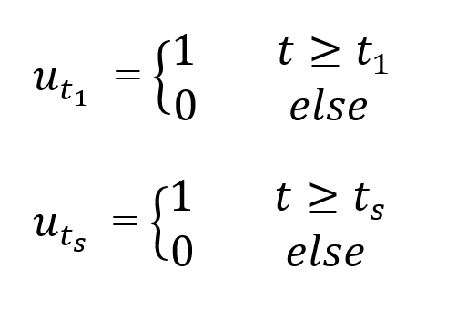
Numerical Model for Flickers and Transients (continue):

Slide 15
Time series to image conversion:
GRAMIAN ANGULAR FIELD
RECURRENCE PLOT
MARKOV TRANSITION FIELD

Slide 16
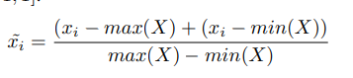
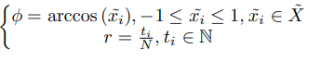
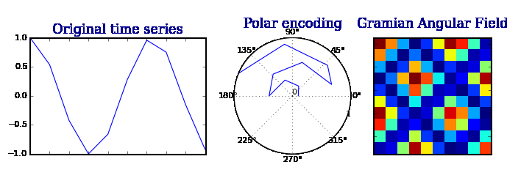
GRAMIAM ANGULAR FIELD:
GAF converts time series in a polar coordinate
system instead of the typical Cartesian
Coordinates. It provides a way to preserve
temporal dependency, since time increases
as the position moves from top-left to
bottom-right.
Notes:
Gramian Angular Field is intrisically linked to the inner product and the corresponding Gram Matrix.

Slide 17
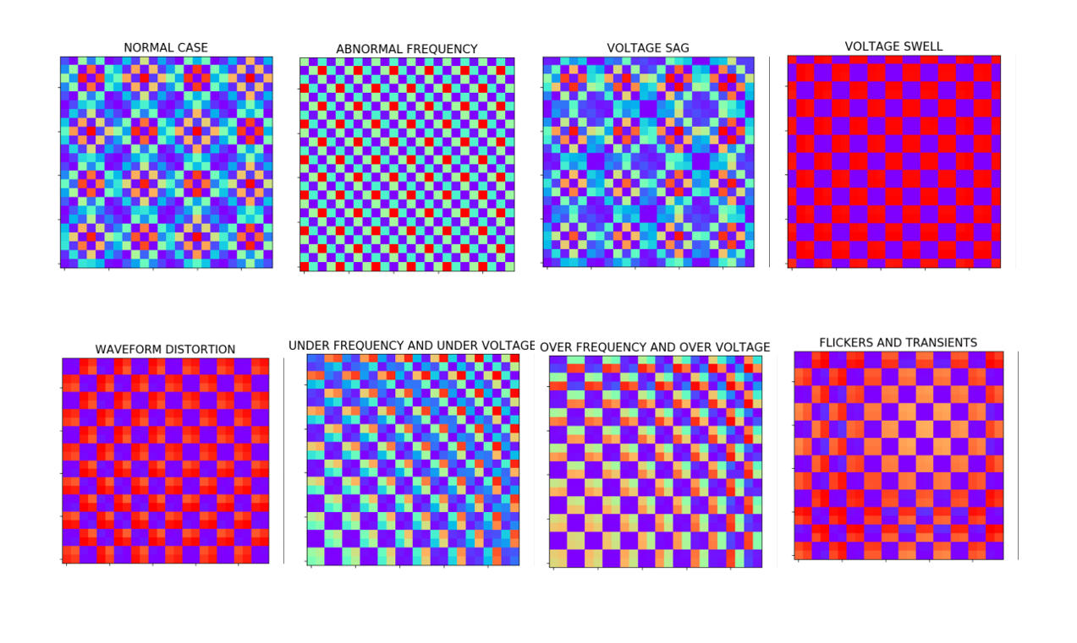
GASF(Gramiam angular summation field):

Slide 18
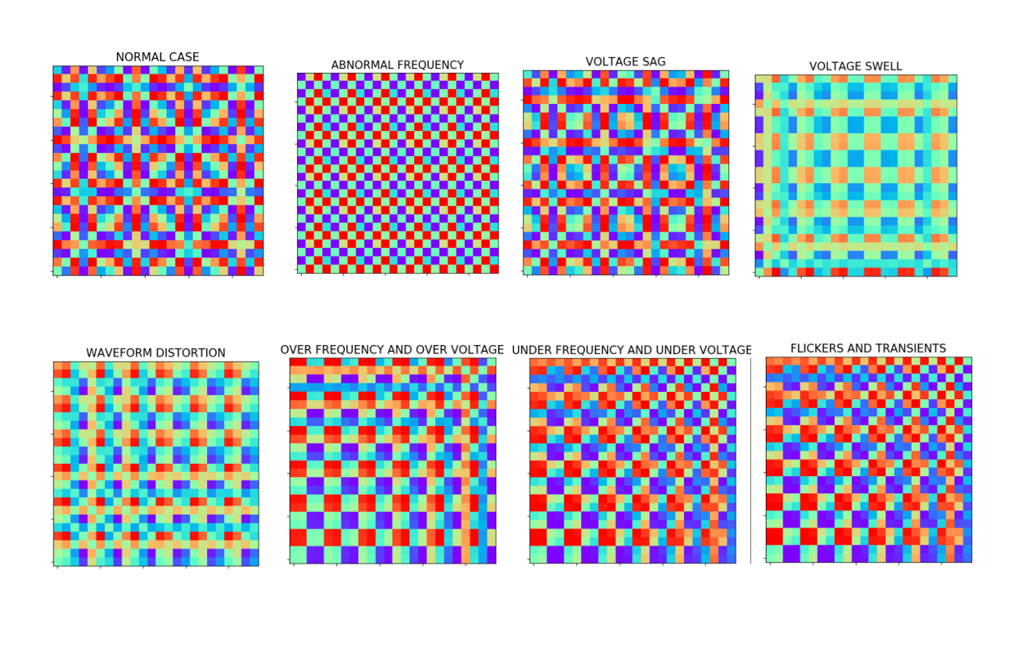
GADF(Gramiam angular difference field):

Slide 19
Recurrence plot:
It is an advanced technique of non linear data analysis .
It is a visualisation (or a graph) of a square matrix, in which the matrix elements correspond to those times at which a state of a dynamical system reoccurs( columns and rows corresponds then to a certain pair of times).
Technically, the RP reveals all the times when the phase trajectory of the dynamical system visits roughly the same area in the phase space.
Notes:
A phase space is a space in which all possible states of s system are represented.
Each axis in phase space corresponds to each state.
State:
State of a system is its condition at a specific time.

Slide 20
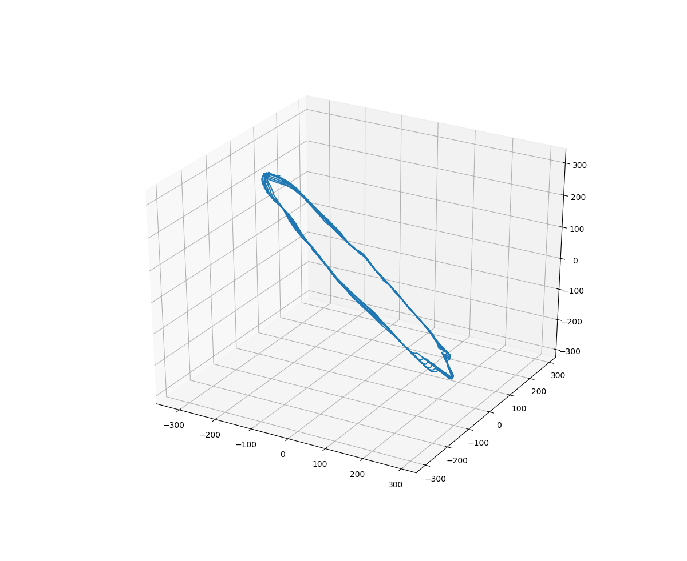
Phase space trajectory

Slide 21
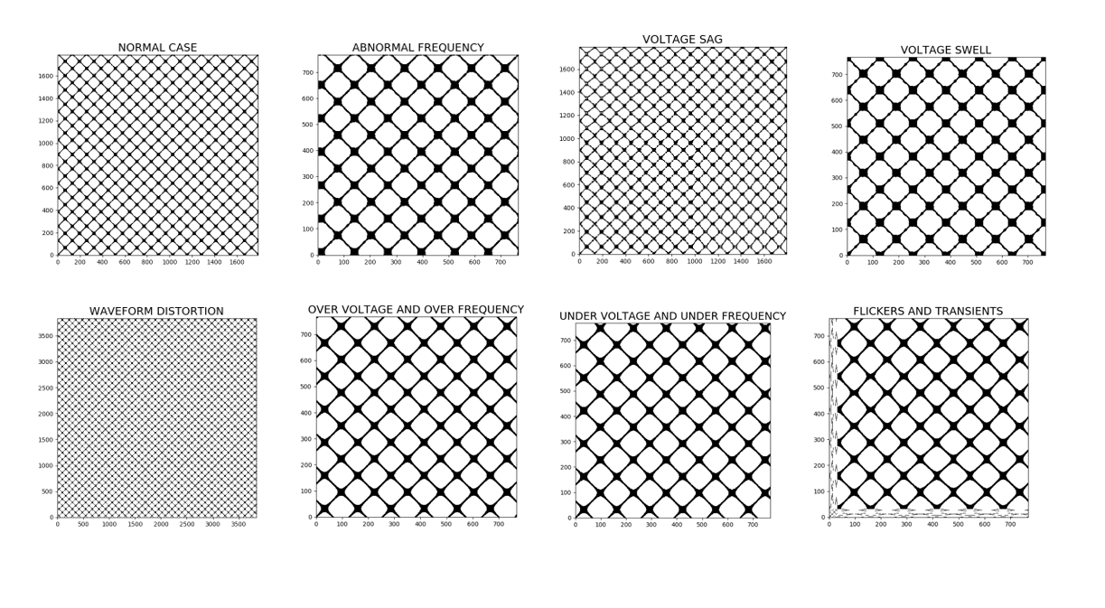

Slide 22
Markov Transition Field:
A Markov Transition Field is an image obtained from a time series, representing a field of transition probabilities for a discretized time series.
In this, we represent Markov transition probabilities sequentially to preserve information in the time domain.
Notes:
Given a time series X ={x1, x2, ..., xn} , we identify its Q quantile bins and assign each xi to the corresponding bins qj (j ∈ [1, Q]). Thus we construct a
Q ⇥ Q weighted adjacency matrix W, which is called Markov transition matrix.
wi,j is given by the frequency with which a point in the quantile qj is followed by a point in the quantile qi . After normalization by ∑ j wij = 1. It is insensitive to the distribution of X and temporal dependency on time steps ti. However, getting rid of the temporal dependency results in too much information loss in matrix W. To overcome this drawback, we define the Markov Transition Field (MTF) as follows:
Mij in MTF denotes the transition probability of qi ! qj . That is, we spread out matrix W which contains the transition probability on the magnitude axis into the MTF matrix by considering the temporal positions.
By assigning the probability from the quantile at time step i to the quantile at time step j at each pixel Mij , the MTF M actually encodes the multi-span transition probabilities of the time series. Mi,j||ij|=k denotes the transition probability between the points with time interval k.
By assigning the probability from the quantile at time step i to the quantile at time step j at each pixel Mij , the MTF M actually encodes the multi-span transition probabilities
of the time series. Mi,j||ij|=k denotes the transition probability between the points with time interval k. For example, Mij|ji=1 illustrates the transition process along the time axis with a skip step. The main diagonal Mii, which is a special case when k = 0 captures the probability from each quantile to itself (the self-transition probability) at time step i. To make the image size manageable and computation more efficient, we reduce the MTF size by averaging the pixels in each non-overlapping m ⇥ m patch with the blurring kernel { 1 m2 }m⇥m. That is, we aggregate the transition probabilities in each subsequence of length m together. Figure 2 shows the procedure to encode time series to MTF.

Slide 23
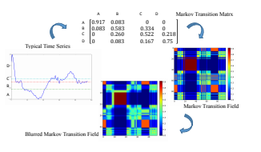

Slide 24
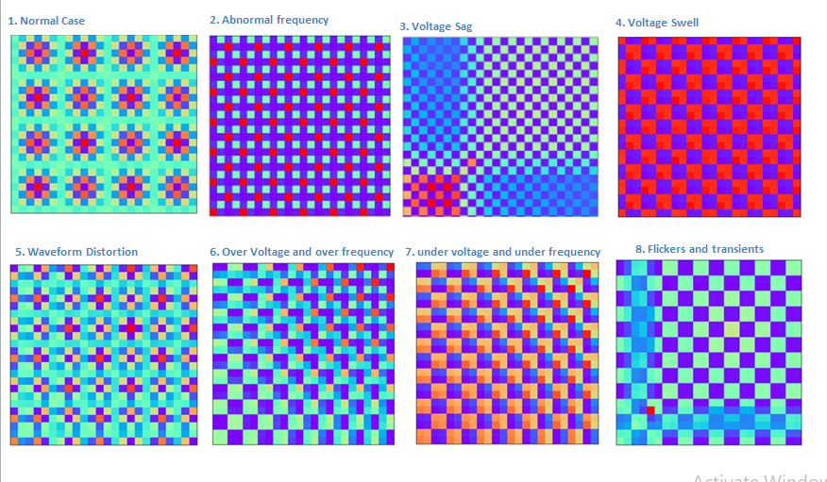
MTF:

Slide 25
FINAL DATASET:
Total 8 events using Markov Transition Field for feature extraction:
Normal case
Abnormal Frequency
Voltage Sag
Voltage Swell
Waveform Distortion
Under Voltage and Under Frequency
Over Voltage and Over Frequency
Flickers and Transients

Slide 26
EXPLORATORY DATA ANALYSIS:
Total no. of events: 8
Noise was added in real data of Voltage sag, Voltage swell and waveform distortion.
New data was generated from these data to increase length of dataset for testing and validation purpose.
Total 8000 images (1000 for each case)
Training set contains 3200 images(400 for each case)
Validation set contains 3200 images(400 for each case)
Testing set contains 1600 images(200 for each case)

Slide 27
ABBREVIATIONS FOR PQ EVENTS:
CODE | EVENT NAME
NC | Normal Case
ABF | Abnormal Frequency
VSG | Voltage Sag
VSW | Voltage Swell
WD | Waveform Distortion
UVF | Under Voltage and Under Frequency
OVF | Over Voltage and Over Frequency
FT | Flickers and Transients

Slide 28
CNN:
A Convolutional Neural Network (ConvNet/CNN) is a Deep Learning algorithm which can take in an input image, assign importance (learnable weights and biases) to various aspects/objects in the image and be able to differentiate one from the other.

Slide 29
MODEL USED:
CNN with Keras
CNN model architecture
3 conv2D layers
Max pooling
1 Flatten layer
2 Dense layers
Optimizer- SGDM (Learning rate =0.01, momentum =0.1)
Activation function- Softmax
Loss function - Categorical cross entropy loss

Slide 30
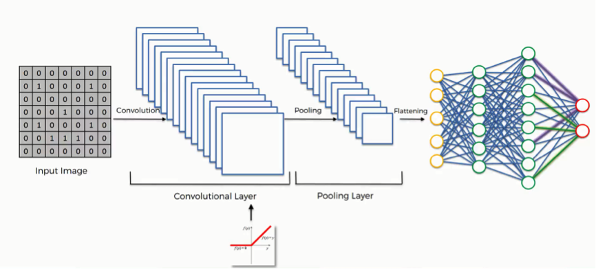

Slide 31
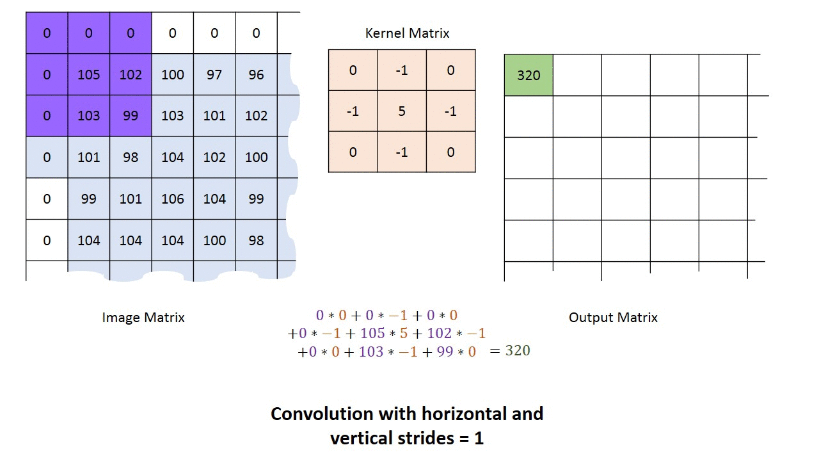
2D CONVOLUTION:

Slide 32
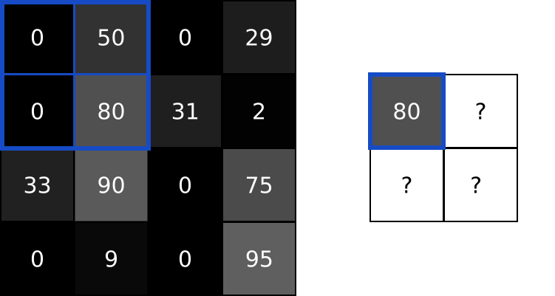
MAX POOLING:

Slide 33

FLATTEN:

Slide 34
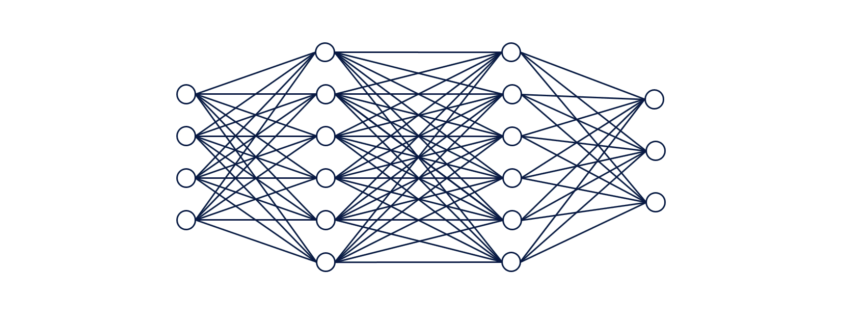
DENSE LAYERS:

Slide 35
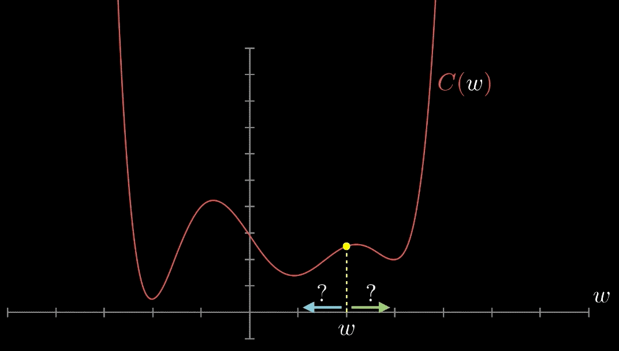
SGDM:
NORMAL GRADIENT DESCENT:

Slide 36
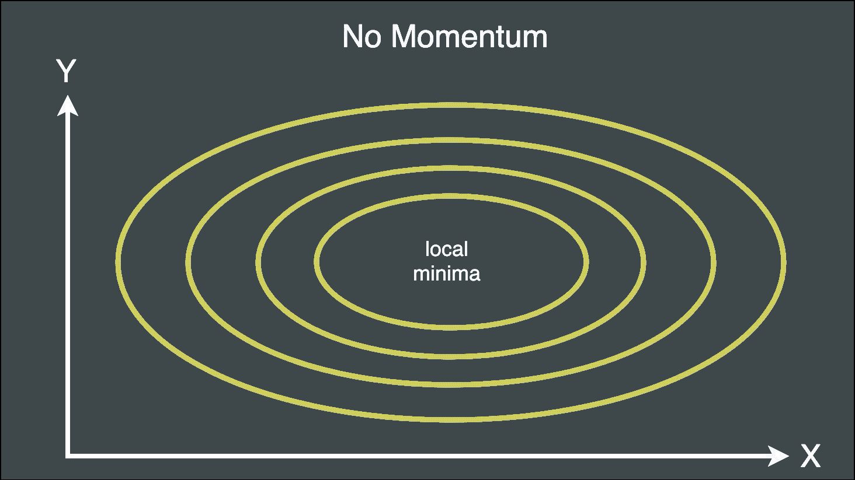
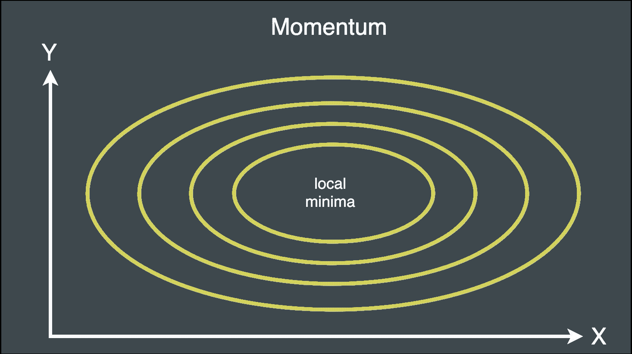
EFFECT OF MOMENTUM:

Slide 37
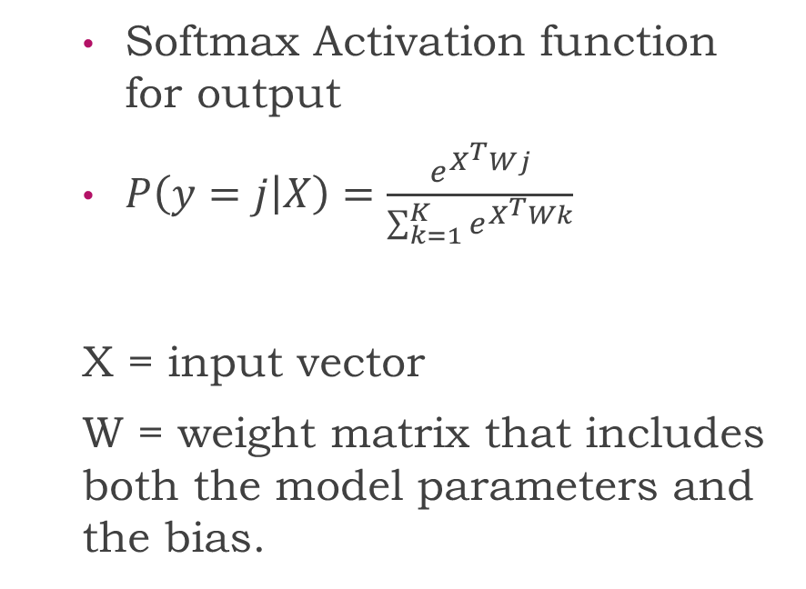
SOFTMAX:
Gives probability of each class
Class with maximum probability is considered as final output

Slide 38
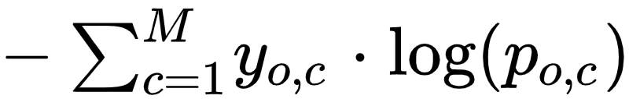
CATEGORICAL CROSS ENTROPY:
Cross-entropy loss, or log loss, measures the performance of a classification model whose output is probability value between 0 and 1. Cross-entropy loss increases as the predicted probability diverges from the actual label.
In binary classification where the number of classification M equals to 2, cross- entropy can be calculated as :
For M>2, it is denoted by :
Here, c =class_id and o=observation_id, p=probability
Here c=class_id and o=observation_id, p=probability

Slide 39
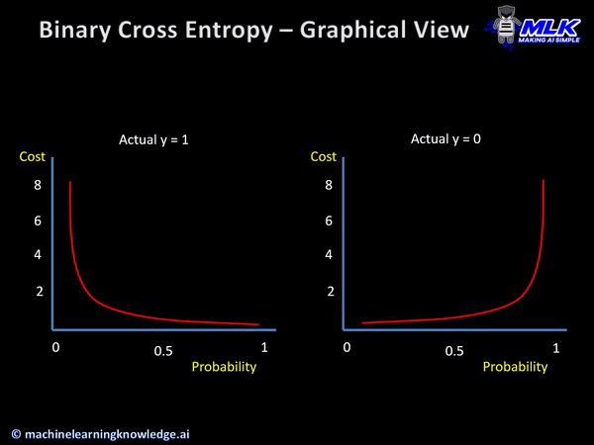

Slide 40
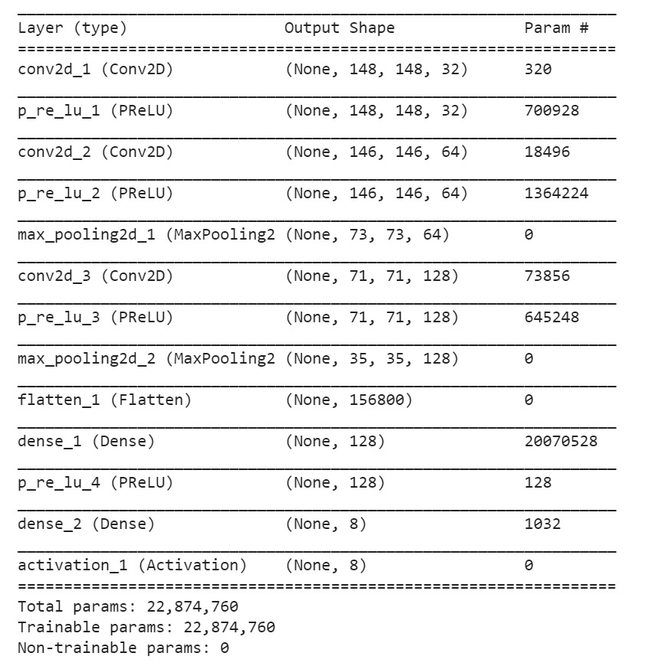
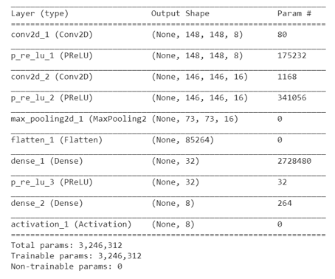
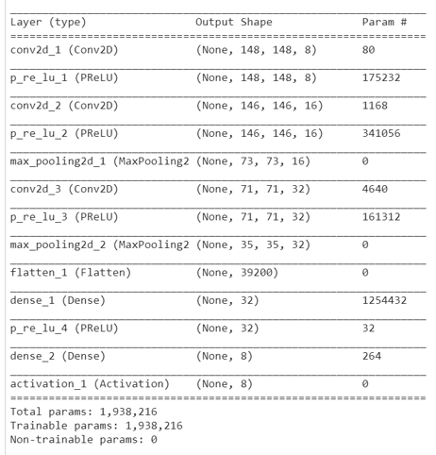

Slide 41
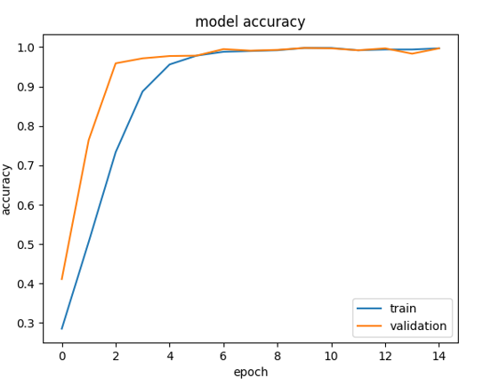
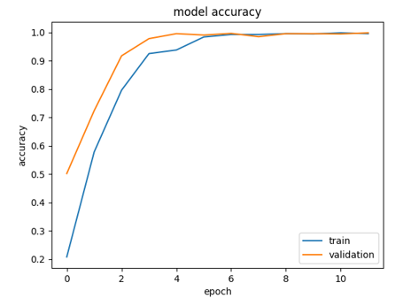
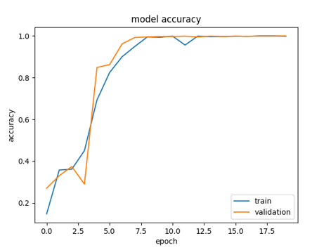
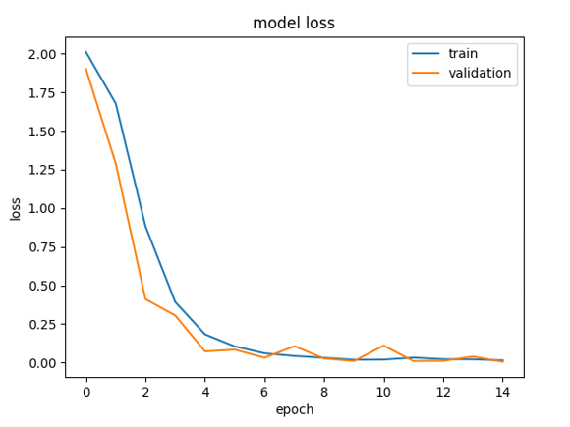
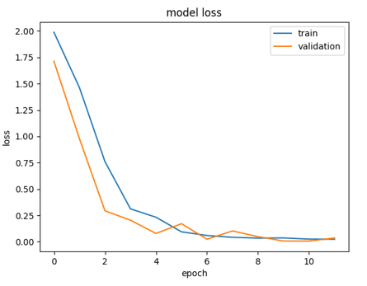
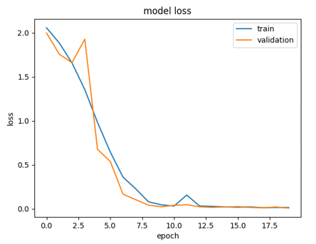

Slide 42
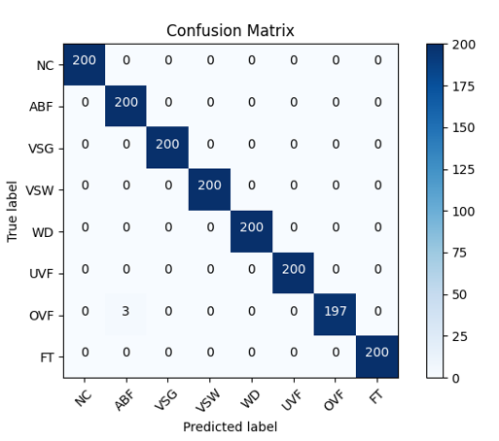
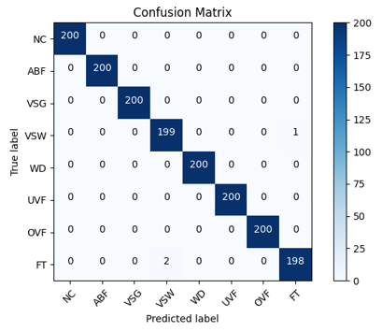
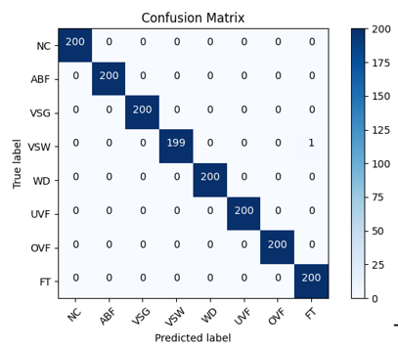

Slide 43
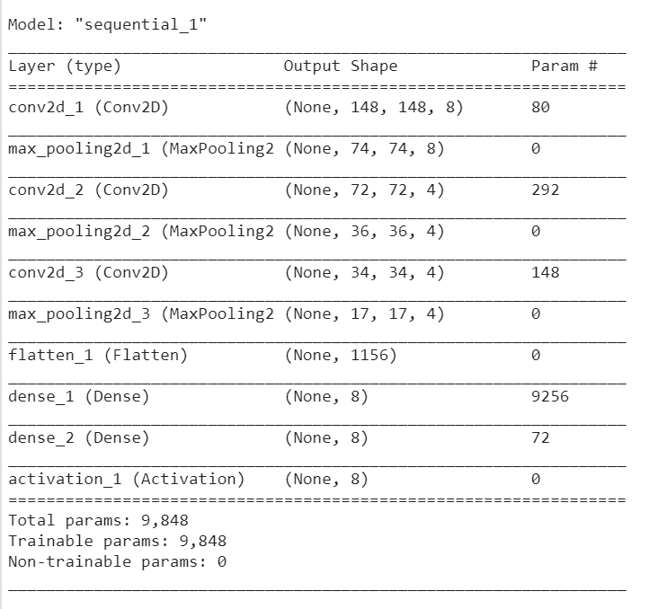
MODEL SUMMARY:

Slide 44
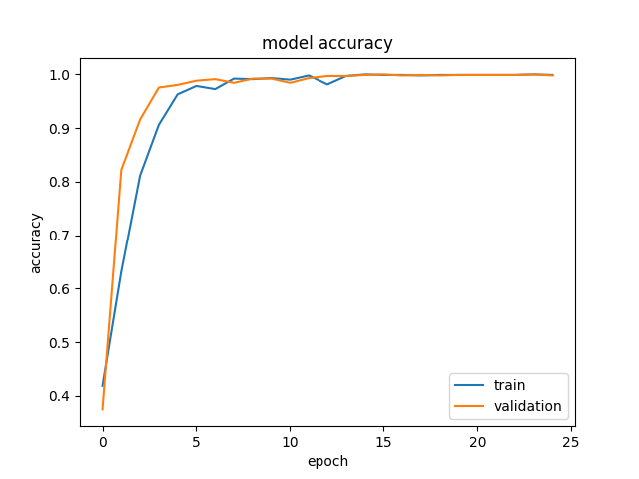
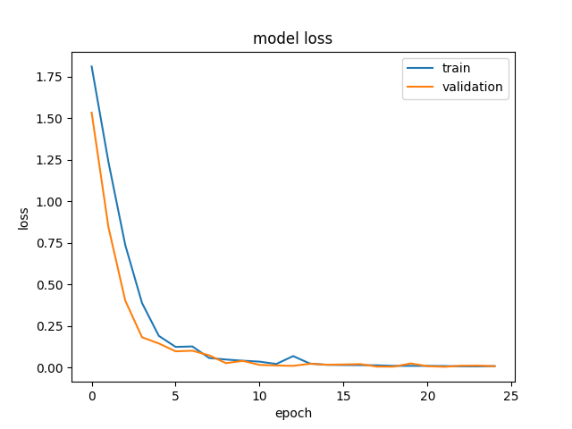
TRAINING RESULTS:

Slide 45
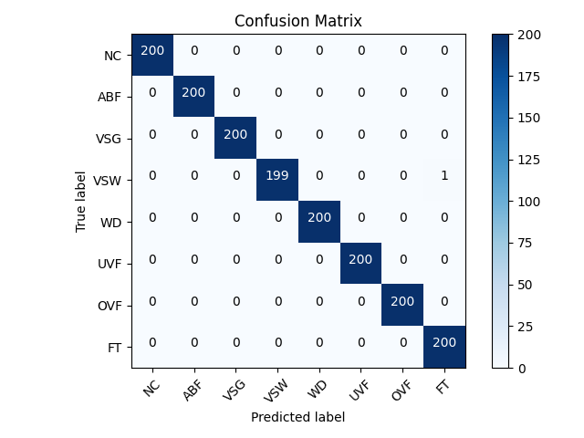
FINAL RESULTS:

Slide 46
References:
[1] | M. Mironovova and J. Bíla, "Fast fourier transform for feature extraction and neural network for classification of electrocardiogram signals," in 2015 Fourth International Conference on Future Generation Communication Technology (FGCT), LUTON,UK, 2015.
[2] | A. Prochazka, J. Kukal and O. Vysata, "Wavelet Transform Use for Feature Extraction and EEG Signal Segments Classification," in 2008 3rd International Symposium on Communications, Control and Signal Processing, ST. JULIANS, 2008.
[3] | S. K. G. Manikonda, S. Gangwani, . S. P. K. Sreckala and J. SANTHOSH, "Power Quality Event Classification Using Convolutional Neural Networks on Images," in 2019 IEEE 1st International Conference on Energy, Systems and Information Processing (ICESIP), CHENNAI, 2019.
[4] | S. K G Manikonda, J. santhosh, . S. P. K. Sreekala and . S. Gangwani , "Power Quality Event Classification Using Long Short-Term Memory Networks," in 2019 IEEE International Conference on Distributed Computing, VLSI, Electrical Circuits and Robotics (DISCOVER), Manipal, India, 2019.
[5] | S. K. G. Manikonda, j. Santhosh, s. p. k. sreekala, S. gangwani and D. n. gaonkar, "Power Quality Event Classification Using Transfer learning on images," in 2019 IEEE International Conference on Intelligent Techniques in Control, Optimization and Signal Processing (INCOS), Tamilnadu, 2019.
[6] | "PQube - Live world map for power quality," Power standards lab, [Online]. Available: http://map.pqube.com/.
[7] | Z. Wang and t. oates, "Encoding Time Series as Images for Visual Inspection and Classification Using Tiled Convolutional Neural Networks," in Workshops at the Twenty-Ninth AAAI Conference on Artificial Intelligence, 2015.
[8] | L. Bottou, "Large-Scale Machine Learning with Stochastic Gradient Descent," in Proceedings of COMPSTAT'2010, 2010.
[12] | D. A. Rob and N. A. Campwell, "On the pairing of the softmax activation and cross entropy penalty functions and derivation of the softmax activation function," in Proc. 8th Aust, Conf. on the Neural Networks,Melbourne,Vol.181, Melbourne, 1997.

Slide 47
THANK YOU :)

